Slide 1
Machine Learning “Paper Presentation” Week V
Lecturer : Mr. Hel Chanthan
Student : Chek Nita

Slide 2
Planning
Week I
Introducing to Machine Learning
Done
Week II
Machine Learning Techniques
Done
Week III
Lab
Done
Week IV
Own Project
In Progressing

Slide 3
Planning For October
October 2020 | Week I | Week II | Week III | Week III
Monday | Preparing & Researching Lab | Trying out some ML techniques | Figure out some formulars | Doing more Research
Tuesday | Preparing & Researching Lab | Preparing about researching | Focus on own project | Testing works
Wednesday | Done Research Lab | Practice code | Use ML to test | Complete works
Thursday | Presentation | Presentation | Presentation | Presentation
Friday | Research about Image Detection | Testing | Improving works | Review works
Saturday | Rewriting Code | Researching | Recoding | Make sure to Finish
Sunday | Practice | Collect Data | Research | Making Report

Slide 4
Outline
Unmanned Aerial System Based Tomato Yield Estimation Using Machine Learning
Purpose of this project
Material and Methods
Machine Learning Techniques
Results
Reference: SPIEDigitalLibrary.org/conference-proceedings-of-spie

Slide 5
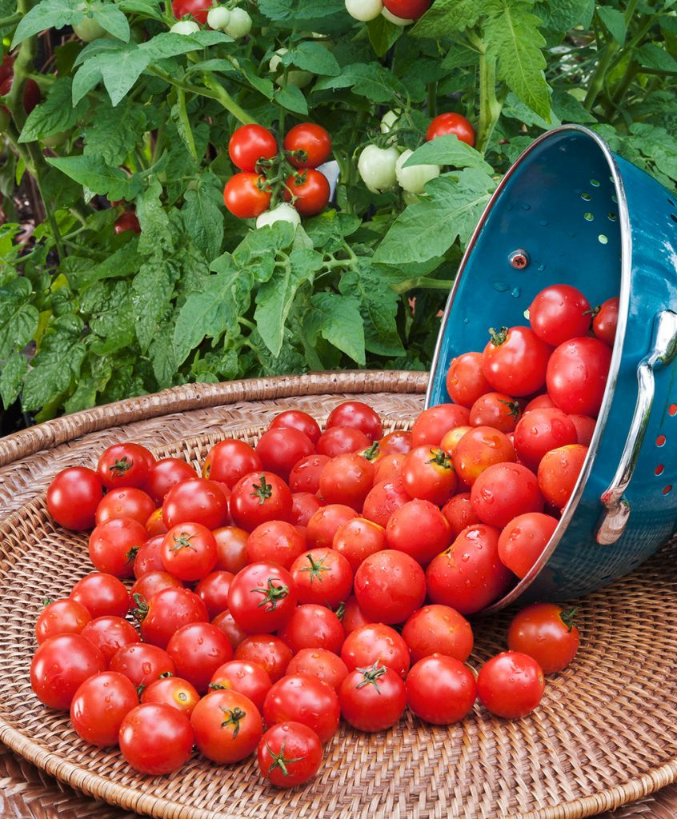
Unmanned Aerial System Based Tomato Yield Estimation Using Machine Learning
Purpose
Predicted the growth of tomato
Help farmers and breeder to improve their crop quality and reducing the operation cost by better decision making on the intensity of the crop harvesting and labor required.
Helps delineating within-field management zones
Ample amount of work can be found in the literature exploring various canopy attributes derived from UAS data such as Canopy Height Model (CHM) , Canopy cover (CC) , Canopy volume (CV) , excessive greenness index (ExG)

Slide 6
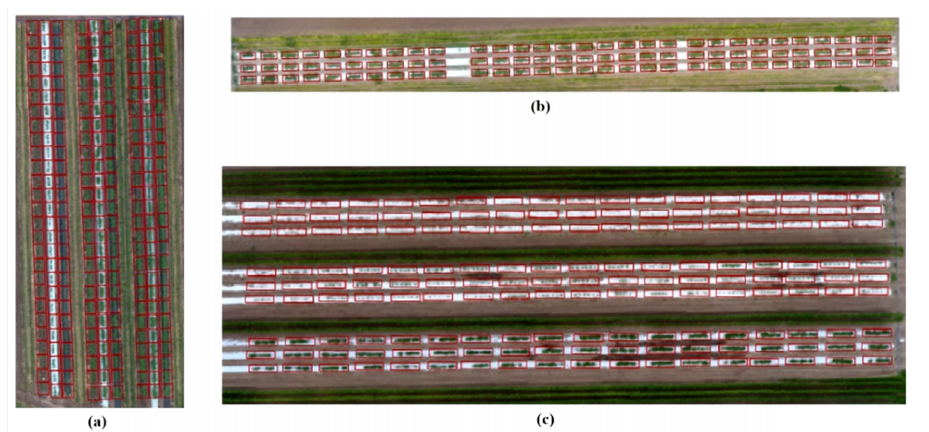
Unmanned Aerial System Based Tomato Yield Estimation Using Machine Learning
Material
Field experiments are established at the Texas A&M AgriLife Research and Extension Center at Weslaco TX, USA
(a) Represent the Field in 2016
(b) Represent the Field in 2016
(c) Represent the Field in 2016

Slide 7
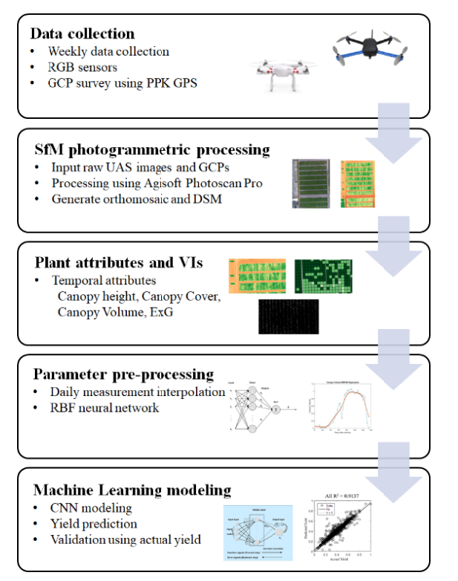
Methods

Slide 8
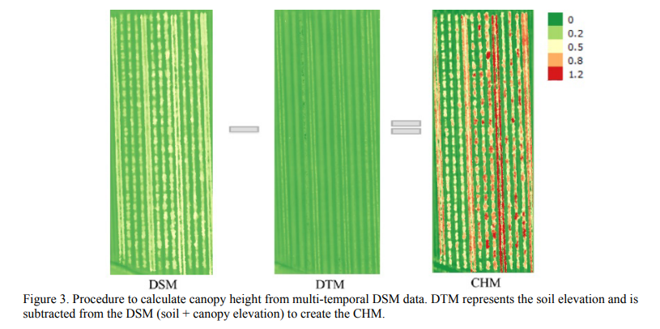
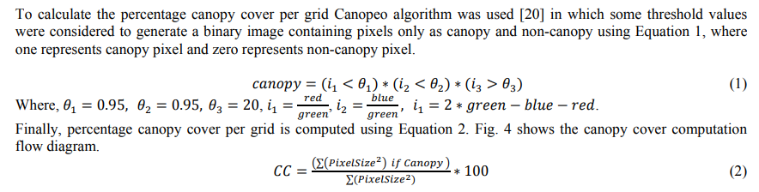

Slide 9
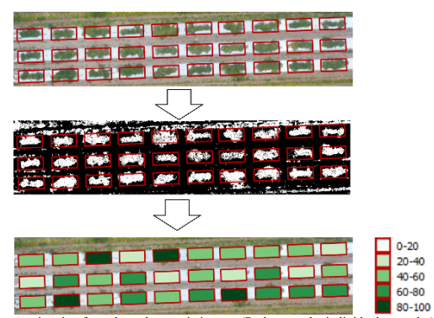
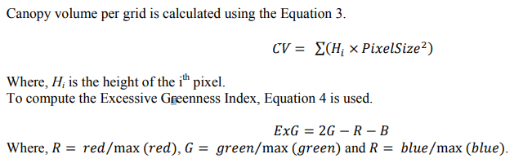
Results

Slide 10
Machine Learning Techniques
In this study, a three-layer ANN is designed for regression consisting of one input layer, one hidden layer followed by an output layer. Traditional linear models are simply inadequate when it comes to modeling data that contains non-linear characteristics.
ANNs are non-linear mapping structures based on the function of the human brain. ANNs are known to be universal function approximators and are capable of exploiting nonlinear relationships between variables. ANNs can identify and learn correlated patterns between input data sets and corresponding target values.

Slide 11
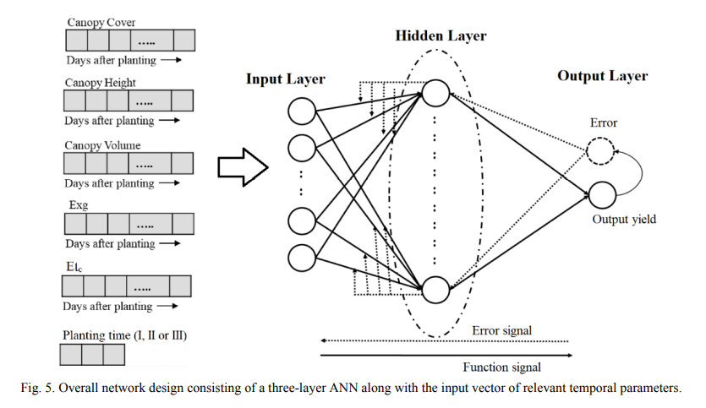

Slide 12
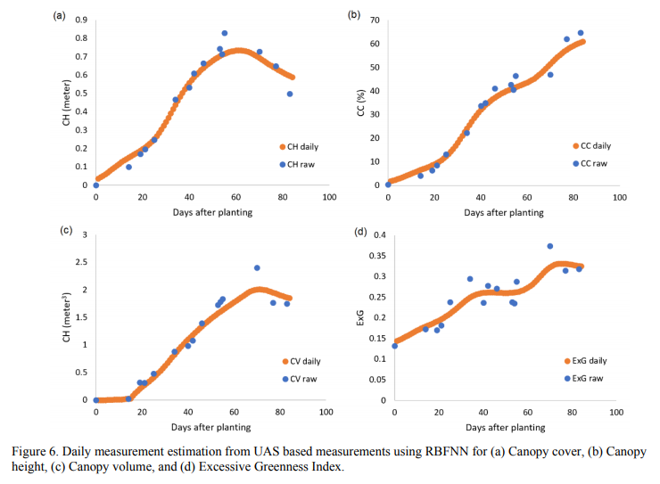
Results
Figure 7, Figure 8 and Figure 9 present the performance of the network and linear fitting results between actual and predicted yield for training and testing, when using only spring 2016, only spring 2017 and only spring 2018 data separately to develop prediction models. In spring 2016, number of training and testing samples were 168 and 72 respectively. In spring 2017, number of training and testing samples were 51 and 21 respectively. In spring 2018, number of training and testing samples were 88 and 37 respectively.

Slide 13
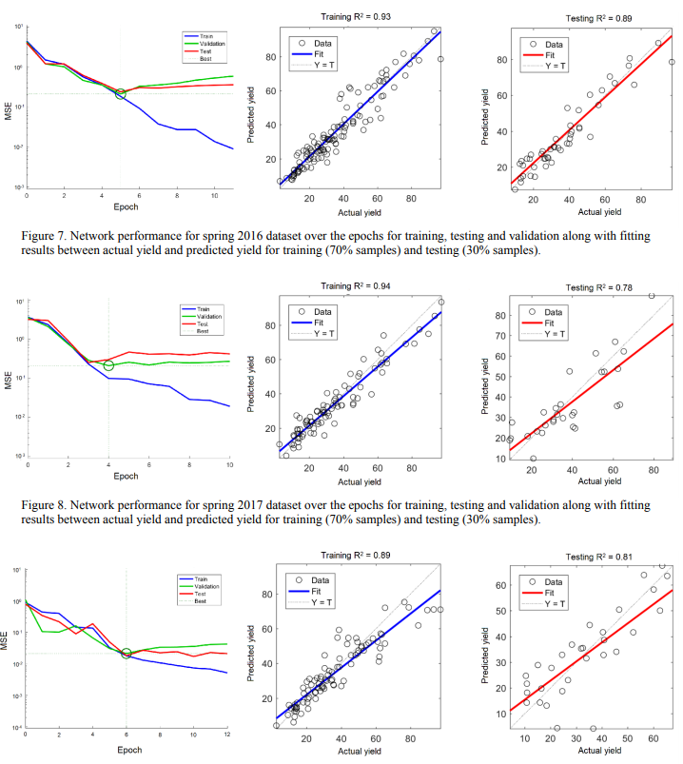

Slide 14
Conclusion
In this study they develop ANN based model to predict the tomato yield using multi-temporal UAS based canopy attribute values and weather information. This study demonstrated how multi-temporal and qualitative features could be incorporated together in a single feature vector to train the ANN based model to estimate the yield of tomato in open environments. The proposed model was initially developed independently for three different seasons namely, spring 2016, spring 2017, and spring 2018, and was able to predict the yield with a high accuracy (R2 ~0.78-0.89).

Slide 15

THANK YOU

